Slide 1
CENTERSTONE SCHOOL-BASED CLINICAL TRAINING SERIES
School-Based Groups
Moving from Planning to Practice
June 2026

Slide 2
CENTERSTONE CLINICAL TRAINING SERIES
TRAINING SERIES
Welcome to Today's Training
Starting School-Based Group therapy
This session is about moving from "I should start a group" to "my first group is running." You will build the skills, structure, and confidence to design, document, and facilitate a school-based therapy group with real clinical value.
Development and Logistics
Objectives — By the end of this training you will be able to:
01
Explain why group therapy is one of the most effective school-based interventions.
This training includes both the developmental phase of creating small groups, exploration of common barriers, and learning how to navigate the electronic health record for new groups and writing group notes.
02
Design a school-based therapy group appropriate for your school setting.
03
Create a practical implementation plan for the first month.
04
Complete all consent, care plan, and Avatar requirements.
05
Launch and facilitate a therapy group with confidence.
SESSION FORMAT
Discussion and hands-on practice

Slide 3
“
Why This Training Matters
Many therapists graduate with strong individual therapy skills but little guidance on creating and facilitating groups. School-based groups create opportunities for connection, peer learning, belonging, and therapeutic change — while allowing clinicians to reach more students.
This training provides a practical framework for moving from "I should start a group" to "my first group is running."
More connection. More reach. Better outcomes.
CENTERSTONE CLINICAL TRAINING SERIES

Slide 4
Training Purpose
Five things you will walk away able to do.
01
02
03
04
05
Understand the Science
Design Your Group
Build Documentation Foundations
Develop Your Curriculum
Launch With Confidence
Learn why group therapy works and how therapeutic change occurs in groups.
Create structure, membership criteria, and logistics.
Prepare consent, care plans, and required records.
Create a structured and repeatable month-one experience.
Leave with a practical plan for implementation.
CENTERSTONE CLINICAL TRAINING SERIES

Slide 5
Why Group Therapy?
Clinical and Practical Benefits
EFFICIENCY
INSIGHT
SKILL TRANSFER
EQUITY
1.98 hrs
360°
2x
Efficiency
Clinical hours generated from one 40-minute group of 6 students — in a single session
Richer clinical insight — observe clients in real peer interaction, not just self-report
Skill generalization — students rehearse communication & emotional regulation in live social moments
Groups ensure every student is seen consistently, even under the highest caseloads
Avoid billing individual and group therapy on the same day for the same client.

Slide 6
The Science Behind It
Yalom, I. D., & Leszcz, M. (2005). The Theory and Practice of Group Psychotherapy, 5th ed. Basic Books.
YALOM'S THERAPEUTIC FACTORS — PART 1
💡
Instillation of Hope — Seeing peers make progress activates the belief that change is possible. In school groups, this is the student who says: I used to feel that way too.
🌐
Universality — I am not alone. Students discover their struggles are shared, reducing shame and isolation before the second session ends.
🤲
Altruism — Helping others heals the helper. When students offer support to peers, they build self-worth and purpose alongside their clinical growth.
📖
Imparting Information — Psychoeducation delivered in group is reinforced by peers, not just the clinician — increasing retention and buy-in.
🌱
Corrective Recapitulation — For many students, the therapy group is the first safe relational container they have experienced. The group itself becomes the intervention.

Slide 7
The Science Behind It (Continued)
Yalom, I. D., & Leszcz, M. (2005). The Theory and Practice of Group Psychotherapy, 5th ed. Basic Books.
🎭
Imitative Behavior
🔗
Interpersonal Learning
🧲
Group Cohesiveness
Students model regulation and coping from each other. You do not have to teach everything — the group does.
The group is a social microcosm. How a student shows up in group is how they show up in life — and the group reflects it back safely.
Belonging is curative. When students feel part of something, attendance climbs, disclosure deepens, and progress accelerates.
🌊
Catharsis
⚙️
Development of Socializing Techniques
🕊️
Existential Factors
Expressing emotion in the presence of empathetic peers is uniquely powerful. Many students experience this for the first time in your group.
Group is a rehearsal space for real life: eye contact, turn-taking, conflict resolution, and repair.
Students grapple together with fairness, grief, and the reality of life. Honor it — do not solve it.
"These factors do not happen by accident — they happen because you designed a space where they could."

Slide 8
Building Your Group
Planning Decisions
Structure Decisions
Logistics Decisions
✅
Open group vs. Closed group
📅
Day and time — minimize instructional disruption
✅
Group size (no fewer than 2, no more than 8)
📍
Location — private, consistent, accessible
✅
Target population and presenting concerns
🚶
Student pickup and return-to-class process
✅
Grade level and developmental stage
📋
Referral and consent process completed before session 1
✅
In-person or virtual format
🔒
Confidentiality explanation to students in session 1
✅
Special materials or equipment needed
📣
Communication plan for teachers and school staff
💬
Discussion: What potential barriers do you already anticipate? How will you plan to address them?

Slide 9
Open vs. Closed Groups
Open Group
Closed Group
ADVANTAGES
ADVANTAGES
New members can join anytime
Deeper cohesion and trust (Yalom & Leszcz, 2005)
Easier to manage in high-turnover school settings
Supports a structured 8–12 week curriculum
Members at different stages model progress for newer members
Stronger therapeutic alliance and disclosure
Yalom's group cohesiveness factor is amplified
LIMITATIONS
Group cohesion takes longer to build
VS
LIMITATIONS
New members disrupt established norms
No entry after group starts
Harder to follow a sequential curriculum
Member absences feel more disruptive
Requires committed intake process upfront
✨
Recommendation for new therapists: Start with a closed group of 4–6 students with a clear 8-week curriculum. Easier to manage, easier to document, and more likely to generate the cohesion that makes groups actually work.
Centerstone Clinical Training Series

Slide 10
Assigning Clients & Group Dynamics
🧩
Assess Functioning Level
🏫
Consider Peer History
📊
Developmental Stage
Match students with similar communication and emotional regulation baselines. Wide gaps create friction that slows the group.
Past conflicts between students can derail a group before it starts. Ask school counselors and teachers before you place.
Grade proximity matters. An 8th grader and a 5th grader may share a diagnosis but not a social world.
⚖️
Balance the Room
🔒
Screen for Safety
📝
Naming Convention
Avoid all-externalizers or all-internalizers. Some contrast creates dynamic peer learning (Yalom & Leszcz, 2005).
Students in active crisis or with severely disruptive behavior may need individual stabilization before joining group.
Group Name + City + School. Example: Social Skills Murfreesboro Cason Lane 3–6.
Centerstone School-Based Services · Group Counseling Training

Slide 11
Consent & Care Plan Requirements
Document Consent
Update the Care Plan
📝
Required for every minor participating in group therapy
🎯
Group therapy must be tied to active treatment plan goals
✅
Obtain parent/guardian consent before session 1
➕
Add a group-related goal/objective or update an existing goal
✅
Obtain student assent
📐
Objectives must be SMART and reflect the group focus
✅
Write a memo to chart documenting verbal consent — include date and who provided it
🔄
Update progress during treatment plan reviews
📋
At group end, document progress and recommend next steps
✅
Consent must be completed before the client attends their first session
⚠️ A client cannot attend group without documented consent and an updated care plan. Build this before session 1 — not after.
Centerstone School-Based Services
Group Therapy Clinical Standards

Slide 12
Outlining Your First Month
Week 1 — Foundation
Week 2 — Universality
Week 3 — Skill Introduction
Week 4 — Deepening
Introductions, group agreements, and establishing safety. Answer: Why are we here? What are the rules? Can I trust this room? Close with one shared hope from each member. Yalom: Instillation of Hope
Normalize. Share common struggles without overexposing. Finish-the-sentence prompts. Goal: no one leaves feeling alone. Yalom: Universality
Introduce your first core skill — emotion ID, grounding, CBT thought log, etc. Check-in ritual established. Students begin to hold the structure. First Core Skill
Review and apply the skill. Peer coaching begins to emerge. Reflect on what the group has built together. Preview weeks 5–8. Peer Coaching Emerges
📌
Every session: Check-In → Skill/Topic → Activity → Reflection → Check-Out. Predictability is safety.

Slide 13
Every Session, Every Time
Consistency is your most powerful clinical tool.
1
2
3
4
5
⏰
📖
🧠
🎯
🪺
Check-In (5 min)
Review & Bridge (5 min)
Skill or Topic (15 min)
Activity or Practice (10 min)
Check-Out (5 min)
Feelings rating, word of the day, or brief round-robin. Sets the tone and gives you a read on the room before you begin.
Recap last session. Did anyone try the skill? What happened? Builds continuity and accountability between sessions.
The clinical heart of the session. Keep it interactive — not a lecture. Psychoeducation, CBT activity, or structured exercise.
Apply the skill. Role play, worksheet, partner exercise, or art-based activity. Yalom: imitative behavior and interpersonal learning activate here.
One word or sentence: What are you leaving with? Closes the loop, provides documentation material, and honors the group.
TOTAL: 40 MINUTES · ADAPTABLE TO 45, 60, OR 90-MINUTE FORMATS
CENTERSTONE GROUP THERAPY FRAMEWORK
STRUCTURE & CONSISTENCY | EVERY SESSION

Slide 14
Avatar NX: Creating Your Group
Group Registration Form — This is where the group is built and members are initially assigned.
1
Open the Group Registration form using the NX search bar.
2
Create a new group. Name format: Group Name + City + School. Example: Social Skills Murfreesboro Cason Lane 3–6
📸
3
Set the start date. Use Auto Assign for the next available ID number.
[INSERT SCREENSHOT: Avatar NX — Group Registration Form]
4
Add members using Group Member Assignment. Select the correct episode for each client — the wrong episode may block note completion.
5
Set the Client Assignment Date to the date on or before their first session.
6
Optional: Schedule a recurring group appointment using the scheduling calendar.
Follow along with presenter OR open for hands-on practice.
Avatar NX UAT (testing environment)

Slide 15
Avatar NX: Scheduling & Group Notes
SCHEDULING
WRITING THE GROUP NOTE
📅
Use the Scheduling Calendar to set recurring group appointments
📝
From Scheduling Calendar, right-click the group appointment → Group Note
Select Step 1: Shared Content; click Yes on default-note warning
➕
Add members through the group registration form before scheduling
Confirm date, note type, location, and existing appointment
➖
Remove members when they transition out — do not delete the group
Enter session topic and interventions; adjust end time; File Note to send To-Dos
❌
Cancel sessions properly when a session does not occur
📋
Step 2: Open each individual Group Note in the To-Do Widget
✅
Check-In members at the start of each session before writing the note
Select objectives tied to session content
Add individualized progress and interaction details
Complete required fields → Final & File (next note opens automatically)
📸 [INSERT SCREENSHOT: Avatar NX — Scheduling Calendar view]
Tip: Always Check-In members before writing the note — uncheckd members will not appear in To-Do group notes.
Centerstone Clinical Training Series

Slide 16
When Things Don't Go As Planned
⚠️
📉
🔒
🗣️
Teacher Resistance
Low Attendance
Confidentiality Breakdowns
One Student Dominating
Communicate early, in writing, and consistently. Offer a predictable schedule so teachers can plan. Your relationship with the teacher is part of the intervention.
Build accountability into group norms. Identify pull factors — is the group time competing with something students value? Adjust logistics before assuming clinical resistance.
Address in session 1 with a group agreement. Return to it when it happens — it is a clinical opportunity, not just a rule violation.
Use structured turn-taking and group roles. Redirect in-session with warmth: "Let us hear from someone who has not shared yet."
🛑
ENDING GROUPS — READ CAREFULLY
Do NOT terminate a group just because it is no longer actively meeting — unless you plan to never run that group again. If the group may run again with new members in the future, leave it open and remove the members instead. Ending a group permanently in Avatar cannot be undone.

Slide 17
You Are Ready.
Before the end of your first week of school, you will have identified your group, recruited your members, secured consent, updated care plans, set up your group in Avatar NX, and shown up for session 1. That is not small. That is clinical leadership.
Decide your group structure Closed, 4–6 students, 8 weeks
Complete consent & care plan updates Before session 1
Set up your group in Avatar NX Using the correct naming convention
Draft your Session 1 plan Check-in → Skill → Activity → Check-out
"Therapeutic change is an enormously complex process that occurs through an intricate interplay of human experiences." — Yalom & Leszcz, 2005
You are now one of those human experiences for your students.
Questions? Reach out to Topher Fuqua to schedule a one-on-one.
Centerstone Clinical Training Series
·

Slide 18
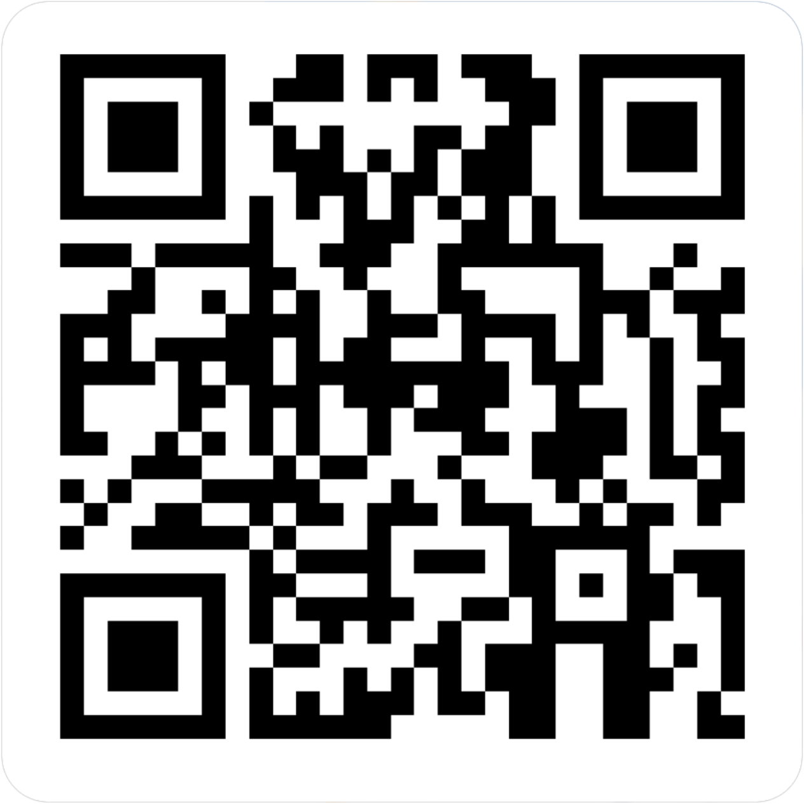
CENTERSTONE SCHOOL-BASED CLINICAL TRAINING SERIES
School-Based Groups
Completion of this survey is required for attendance verification for today’s training.
https://forms.office.com/r/EXVCQtPbti

